Slide 1
Closed-Loop Physical Optimization
of Soft Sensorized Gloves
and High-Reproducible Sensor Print
Sojiro Sugiura
Nagoya University
Engineering, 1st doctoral student
Intelligence robotics laboratory

Slide 2
Problems and contributions
Problems:
Low reproducibility of the 3D print
High base-resistance and low viscosity lower sensor quality
Complex sensor morphology on thumb
Contributions:
Automatic print setup increased print reproducibility
Material that lowers baseline while enhances viscosity
Closed-loop optimization for finding better sensor shape
Keywords:
Soft sensor
3D print
Wearable glove
Optimization

Slide 3
5 bullets list
Goal:
Finding out complex morphology of soft sensor printed on glove to detect specific motion of hand
Problems:
Complex mechanism of thumb to detect hand motion accurately using printable soft sensor
Hypothesis:
Closed-loop optimization cycle will improve the sensitivity gradually, and quick & high-reproducible 3D print setup is needed
Proof:
Bayesian optimization found shape which is only sensitive for specific motion through 40 cycles. It turned out this process was personalization rather than general optimization.
Conclusion:
Closed-loop optimization of physical printable sensor can find better shape of sensor for specific purpose

Slide 4
Index
1. Introduction
Overview of hydrogel and glove sensor → prblems and approach
2. 3D printer
2.1. Printer Setup, 2.2. Automatic Print Diagram
3. Hydrogel
3.1. Print Quality, 3.2. Electrical Property
4. Sensor shape
4.1. Basic shapes, 4.2. Optimization Process, 4.3. Results
5. Discussion
6. Conclusion
1. Introduction
Overview of hydrogel and glove sensor → prblems and approach
2. Material
2.1. Automatic 3D print setup, 2.2. Hydrogel with Corn flour
3. Optimization method
3.1. Basic results, 3.2. Bayesian, 3.3. Parameters
4. Results & Discussion
5. Conclusion

Slide 5
Figures
Fig.1 Our proposed optimization cycle
Fig.2 Setup of the automatic 3D printer and print diagram.
Fig.3 Print quality & electric property of the hydrogel containing cornflour
Fig.4 Sensitivity according to the sensor shape. Repeatability
Fig.5 Optimization diagram and parameters
Fig.6 Gloves in the process of the optimization and results

Slide 6
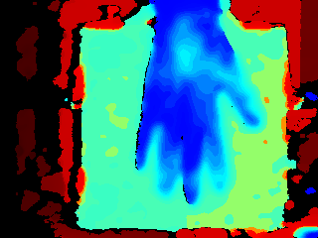
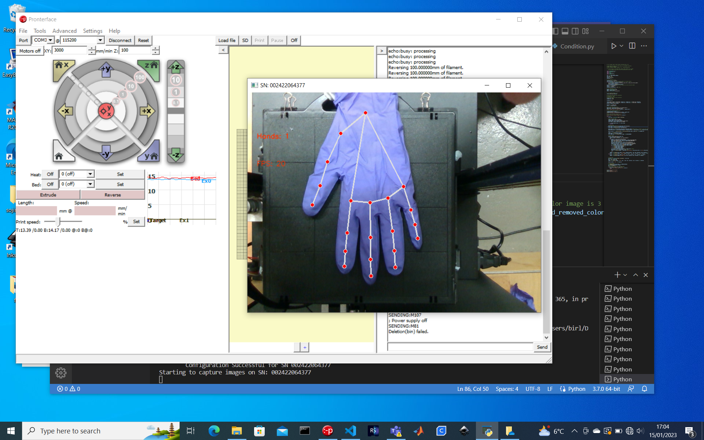

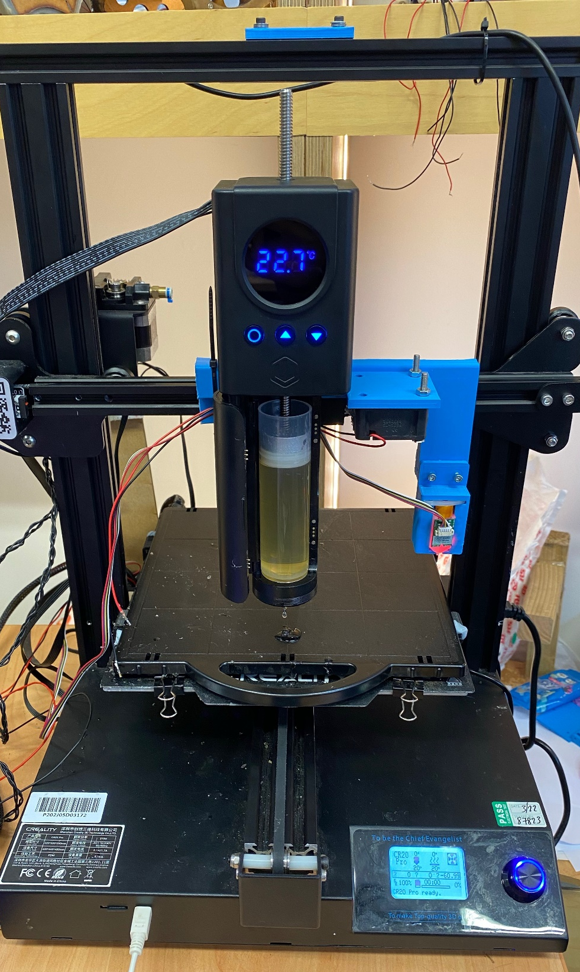
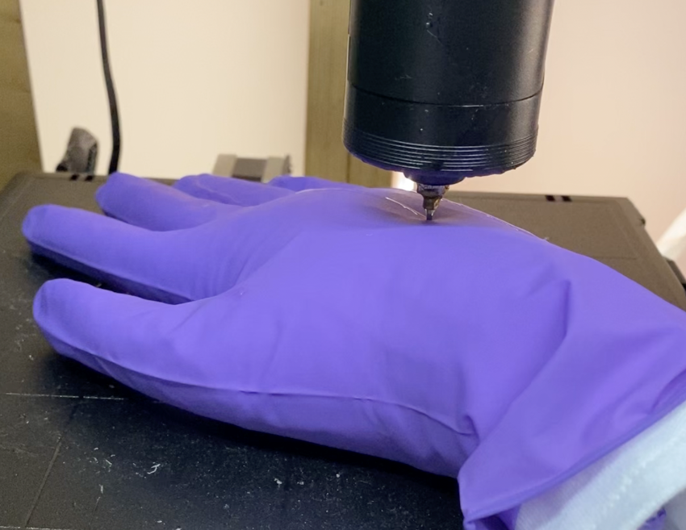
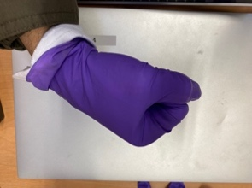
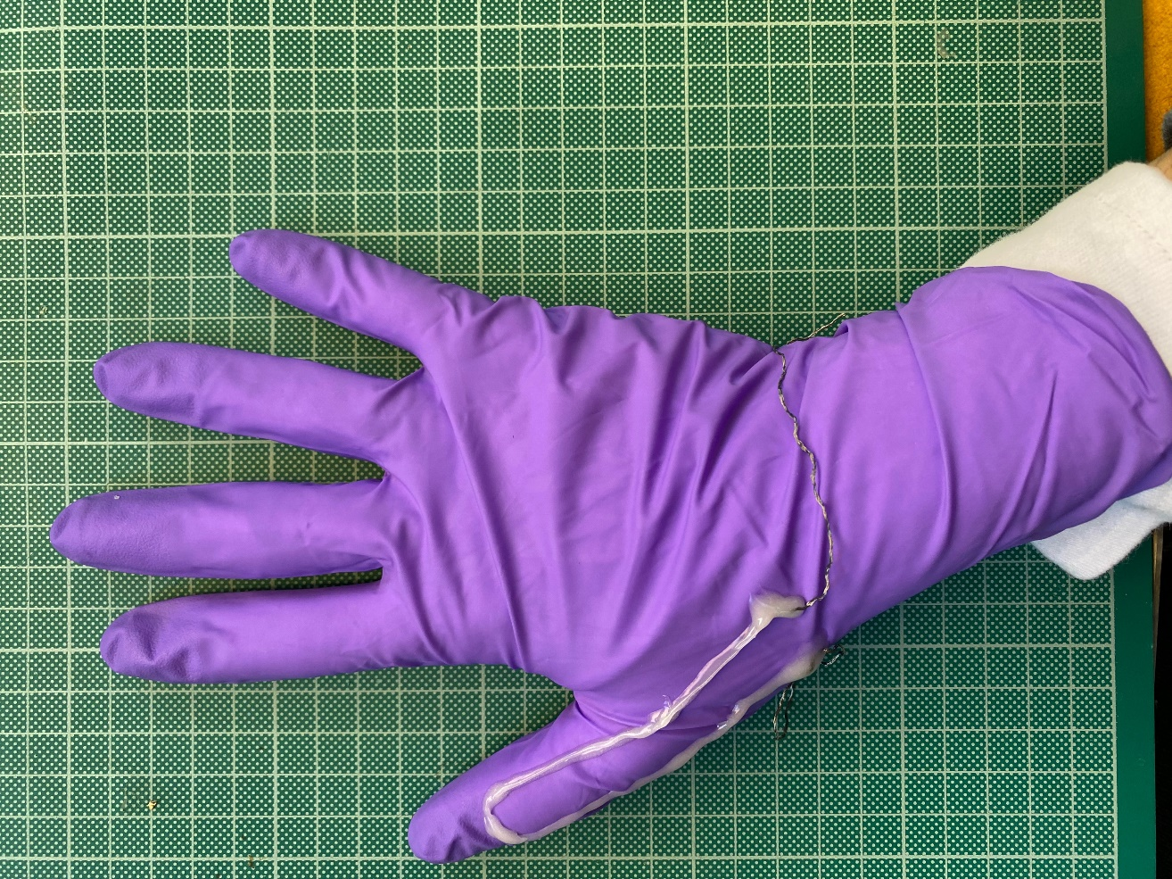
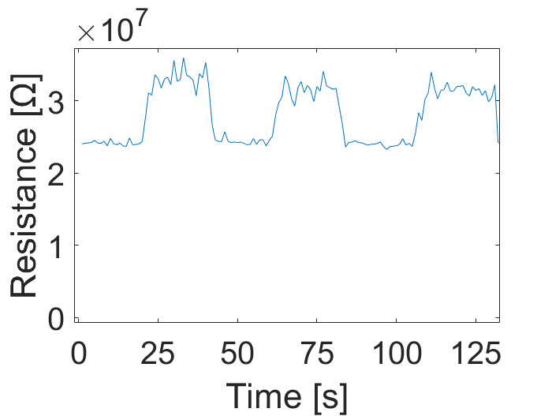
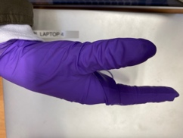
Figure1 Overview
Output
Iteration
Fig.1 Overview of this study

Slide 7



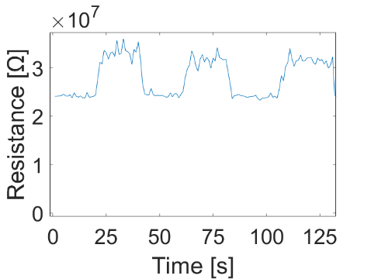
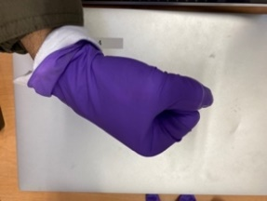


Figure1 Overview
Hand scan
Sensitivity
Iteration
Print
Optimization
3D printer
Measurement
Printed sensor
Fig.1 Overview of this study

Slide 8
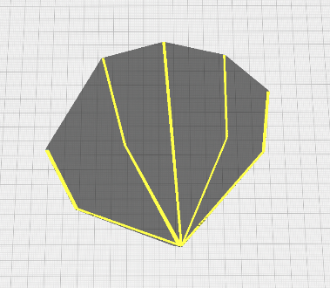
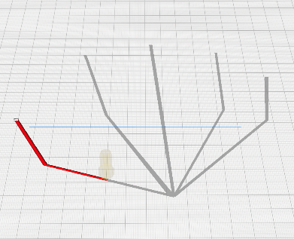
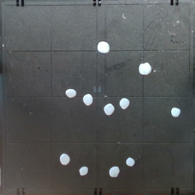
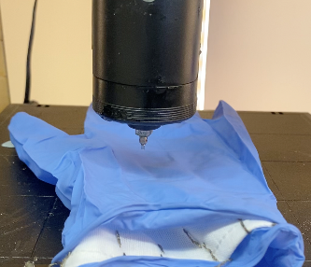

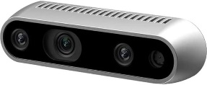
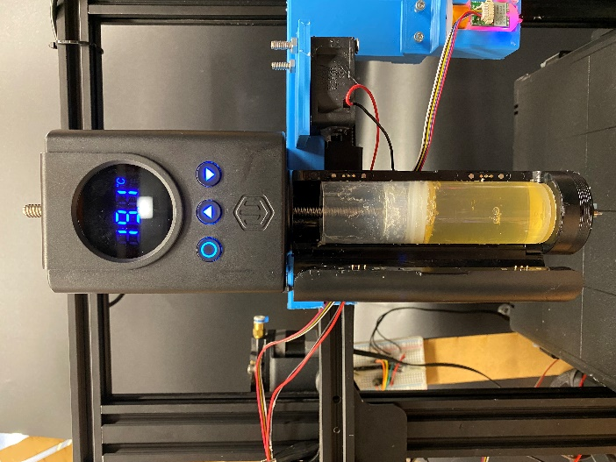
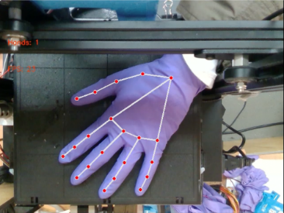

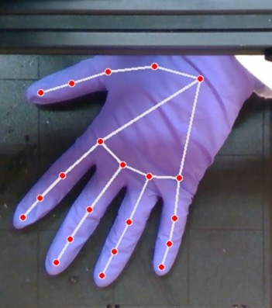
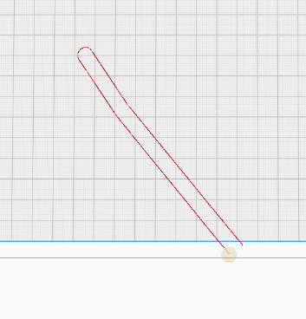
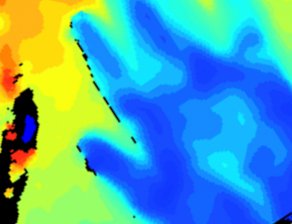
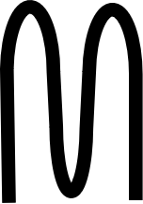


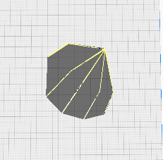
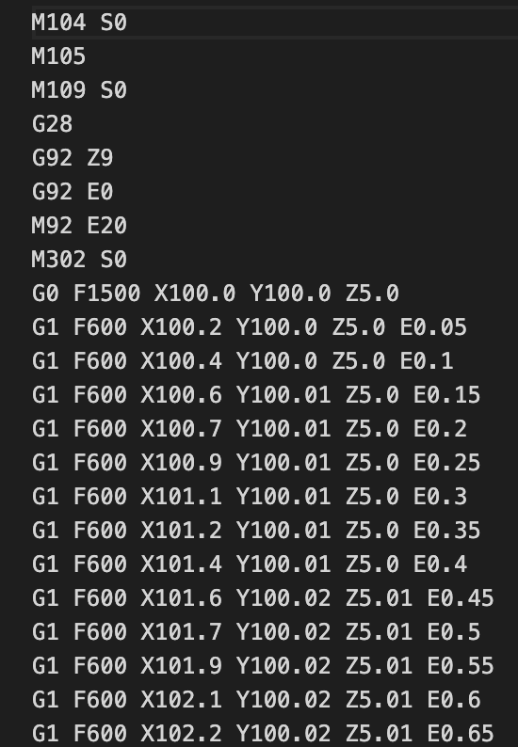

Figure1 (Automatic 3D printer)
① Make 2D model
② Generate print-code
③
Set target points
on print-plate
④
Set object
on the points
(a) Manual setup of 3D print
a)
b)
Camera information
Camera
RGB-Stereo camera
Computer
Camera vision
Print command
Heated nozzle
& Hydrogel
3D printer
3D printer
c)
① Sensor shape selection
Width
Pattern
Length
② Hand detection
③
XY trajectory
planning
④
Height
measurement
⑤ Coordinate transformation
⑥ Print code generation
⑦ Print start
Speed
X point
Command type
Camera
640×480
Print plate
225×225
Extrusion amount
Y, Z point
Fig.2 Setup of the automatic 3D printer: nozzle, camera, and print diagram.

Slide 9
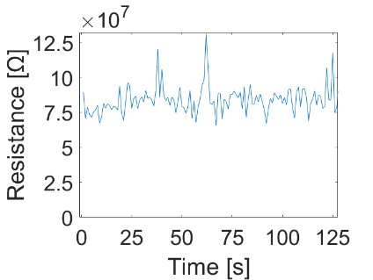
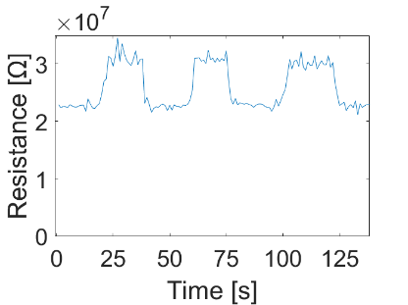
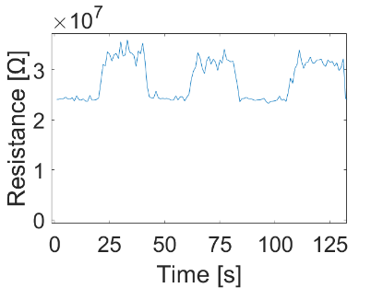

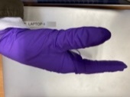
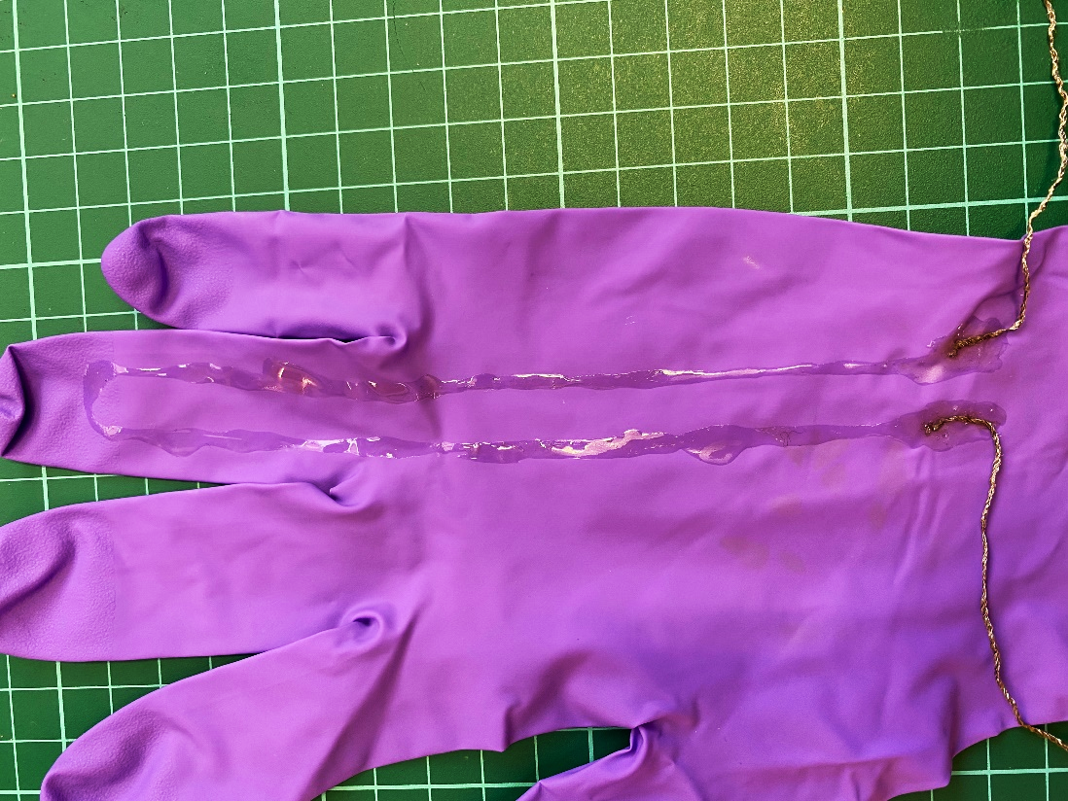
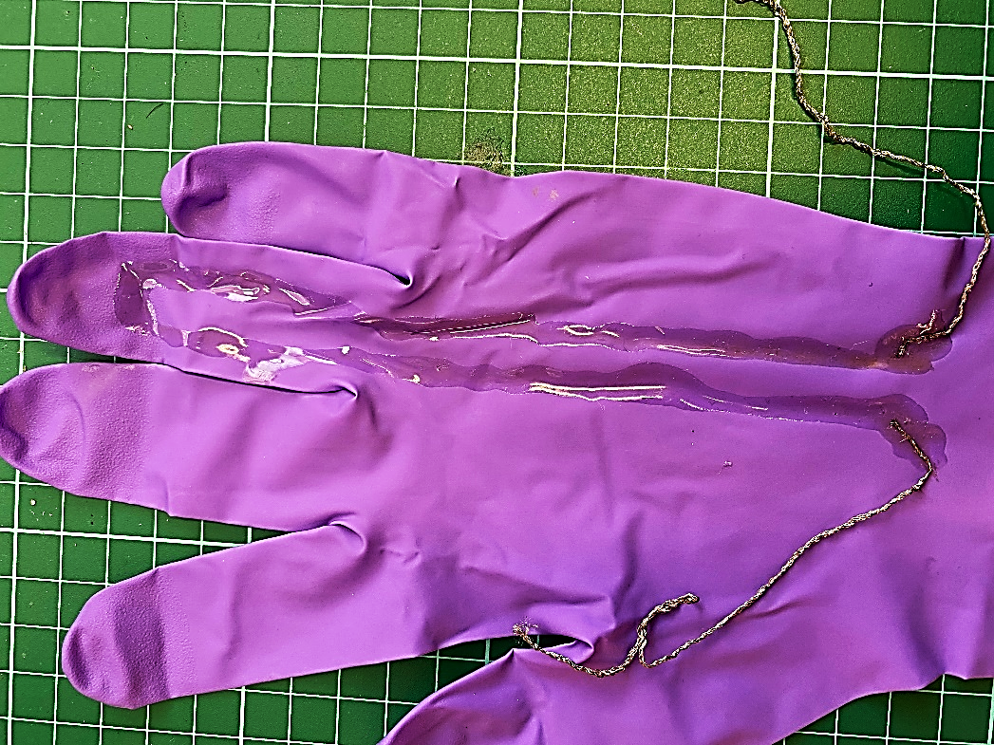
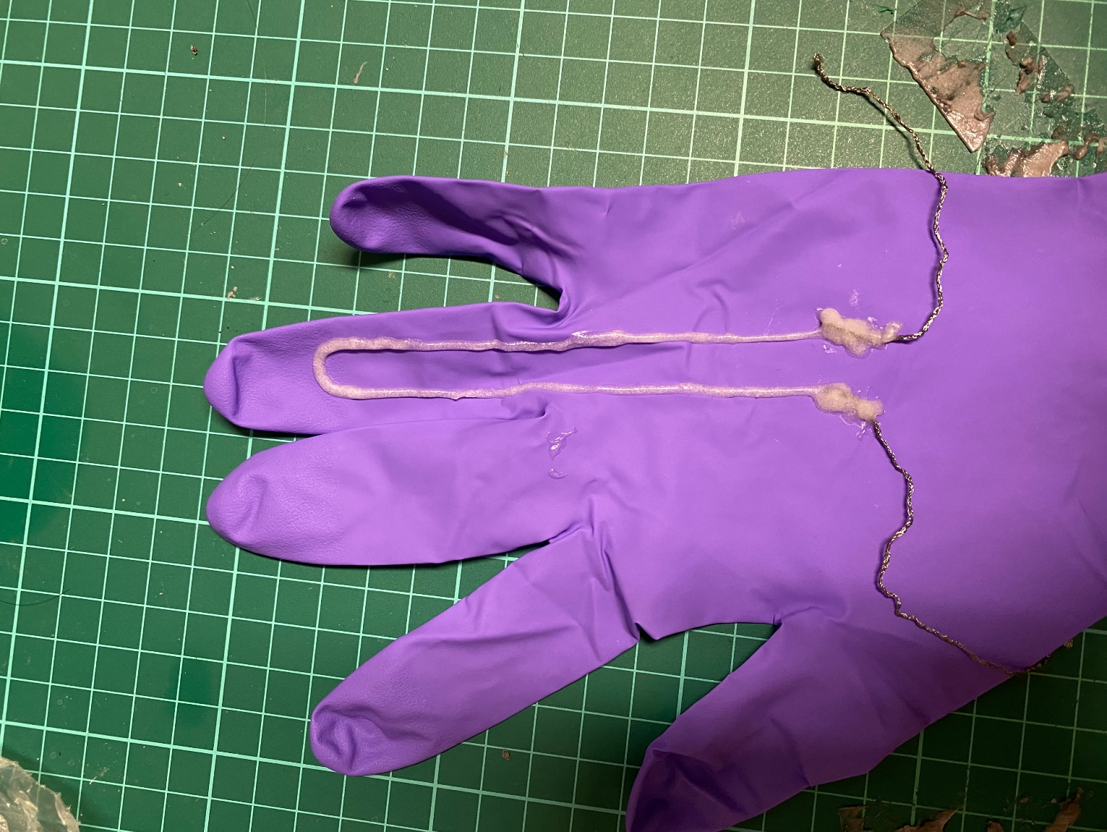
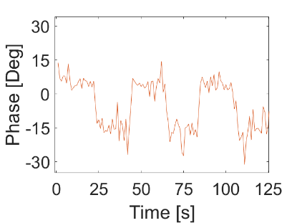
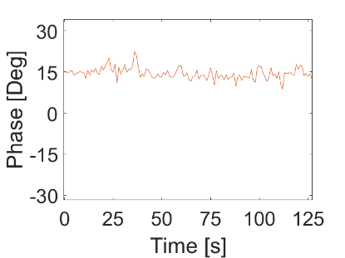
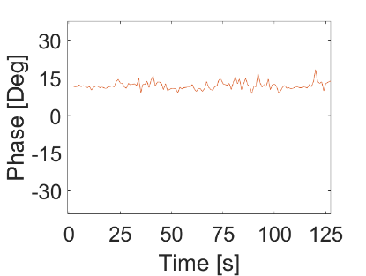
Figure3 and Table1 Stability of sensor
 | Material | Thickness | Contact angle or height | Base resistance | Phase shift
1 | Normal hydrogel | 4 mm |  | 80 MΩ | -30 deg - 15 deg
2 | Normal hydrogel | 8 mm |  | 22 MΩ | 15 deg
3 | Salt 4 → 8%wt | 4 mm
4 | Gelatine 40 → 50%wt | 2 mm
4 | Gelatine 40 → 60%wt | 2 mm
5 | + Corn-flour 20%wt | 2 mm
6 | + Corn-flour 40%wt | 2 mm
7 | + Glaphene 10%wt | 2 mm
8 | + Glaphene 20%wt | 2 mm
Target
Low base resistance (includes time scale effect)
Thin printed
Fig.3: Thin printed sensor shows high baseline resistance and dominant capacitance. Thick printed sensor has better electric properties, but its viscosity is too low to print accurate and complex shapes
Rapid viscosity increase ← Contact angle
Apporopriate viscosity ← Mesh test
Material electric property ← cast test
① Thin sensor
② Thick sensor
③ Corn-flour sensor
Thickness: 4 mm
Base resistance: 80 MΩ
Phase shift: -30 - 15 deg
Thickness: 8 mm
Base resistance: 22 MΩ
Phase shift: 15 deg
Thickness: 2 mm
Base resistance: 25 MΩ
Phase shift: 13 deg
Base resistance
Try some materials (Normal, more salt, more gelatine, glaphene, cornflour)
Normal is low viscous, thixotropy is also low
Salt does not affect the viscosity, but improves the base resistance
Gelatine enhances its viscosity and thixotropy too much (Extrusion is difficult)
Cornflour enhances its viscosity and thixotropy well
Glaphene enhance its thixotropy, but not viscosity
Notes:
Line thicker, Font, align

Slide 10
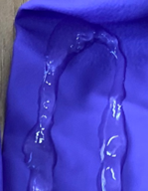
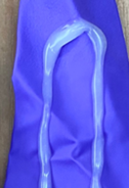
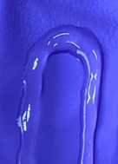
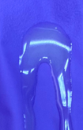
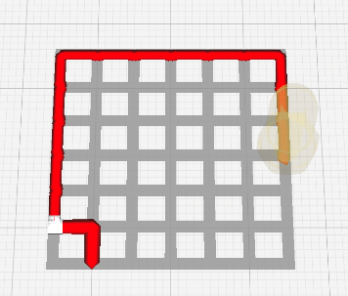
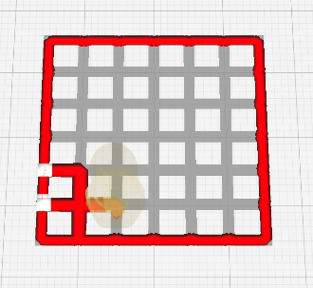
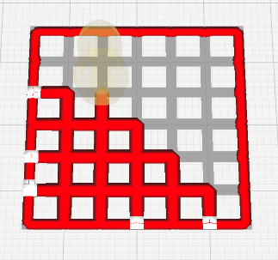
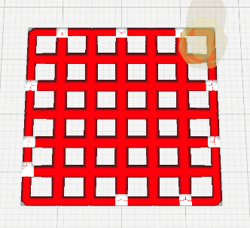
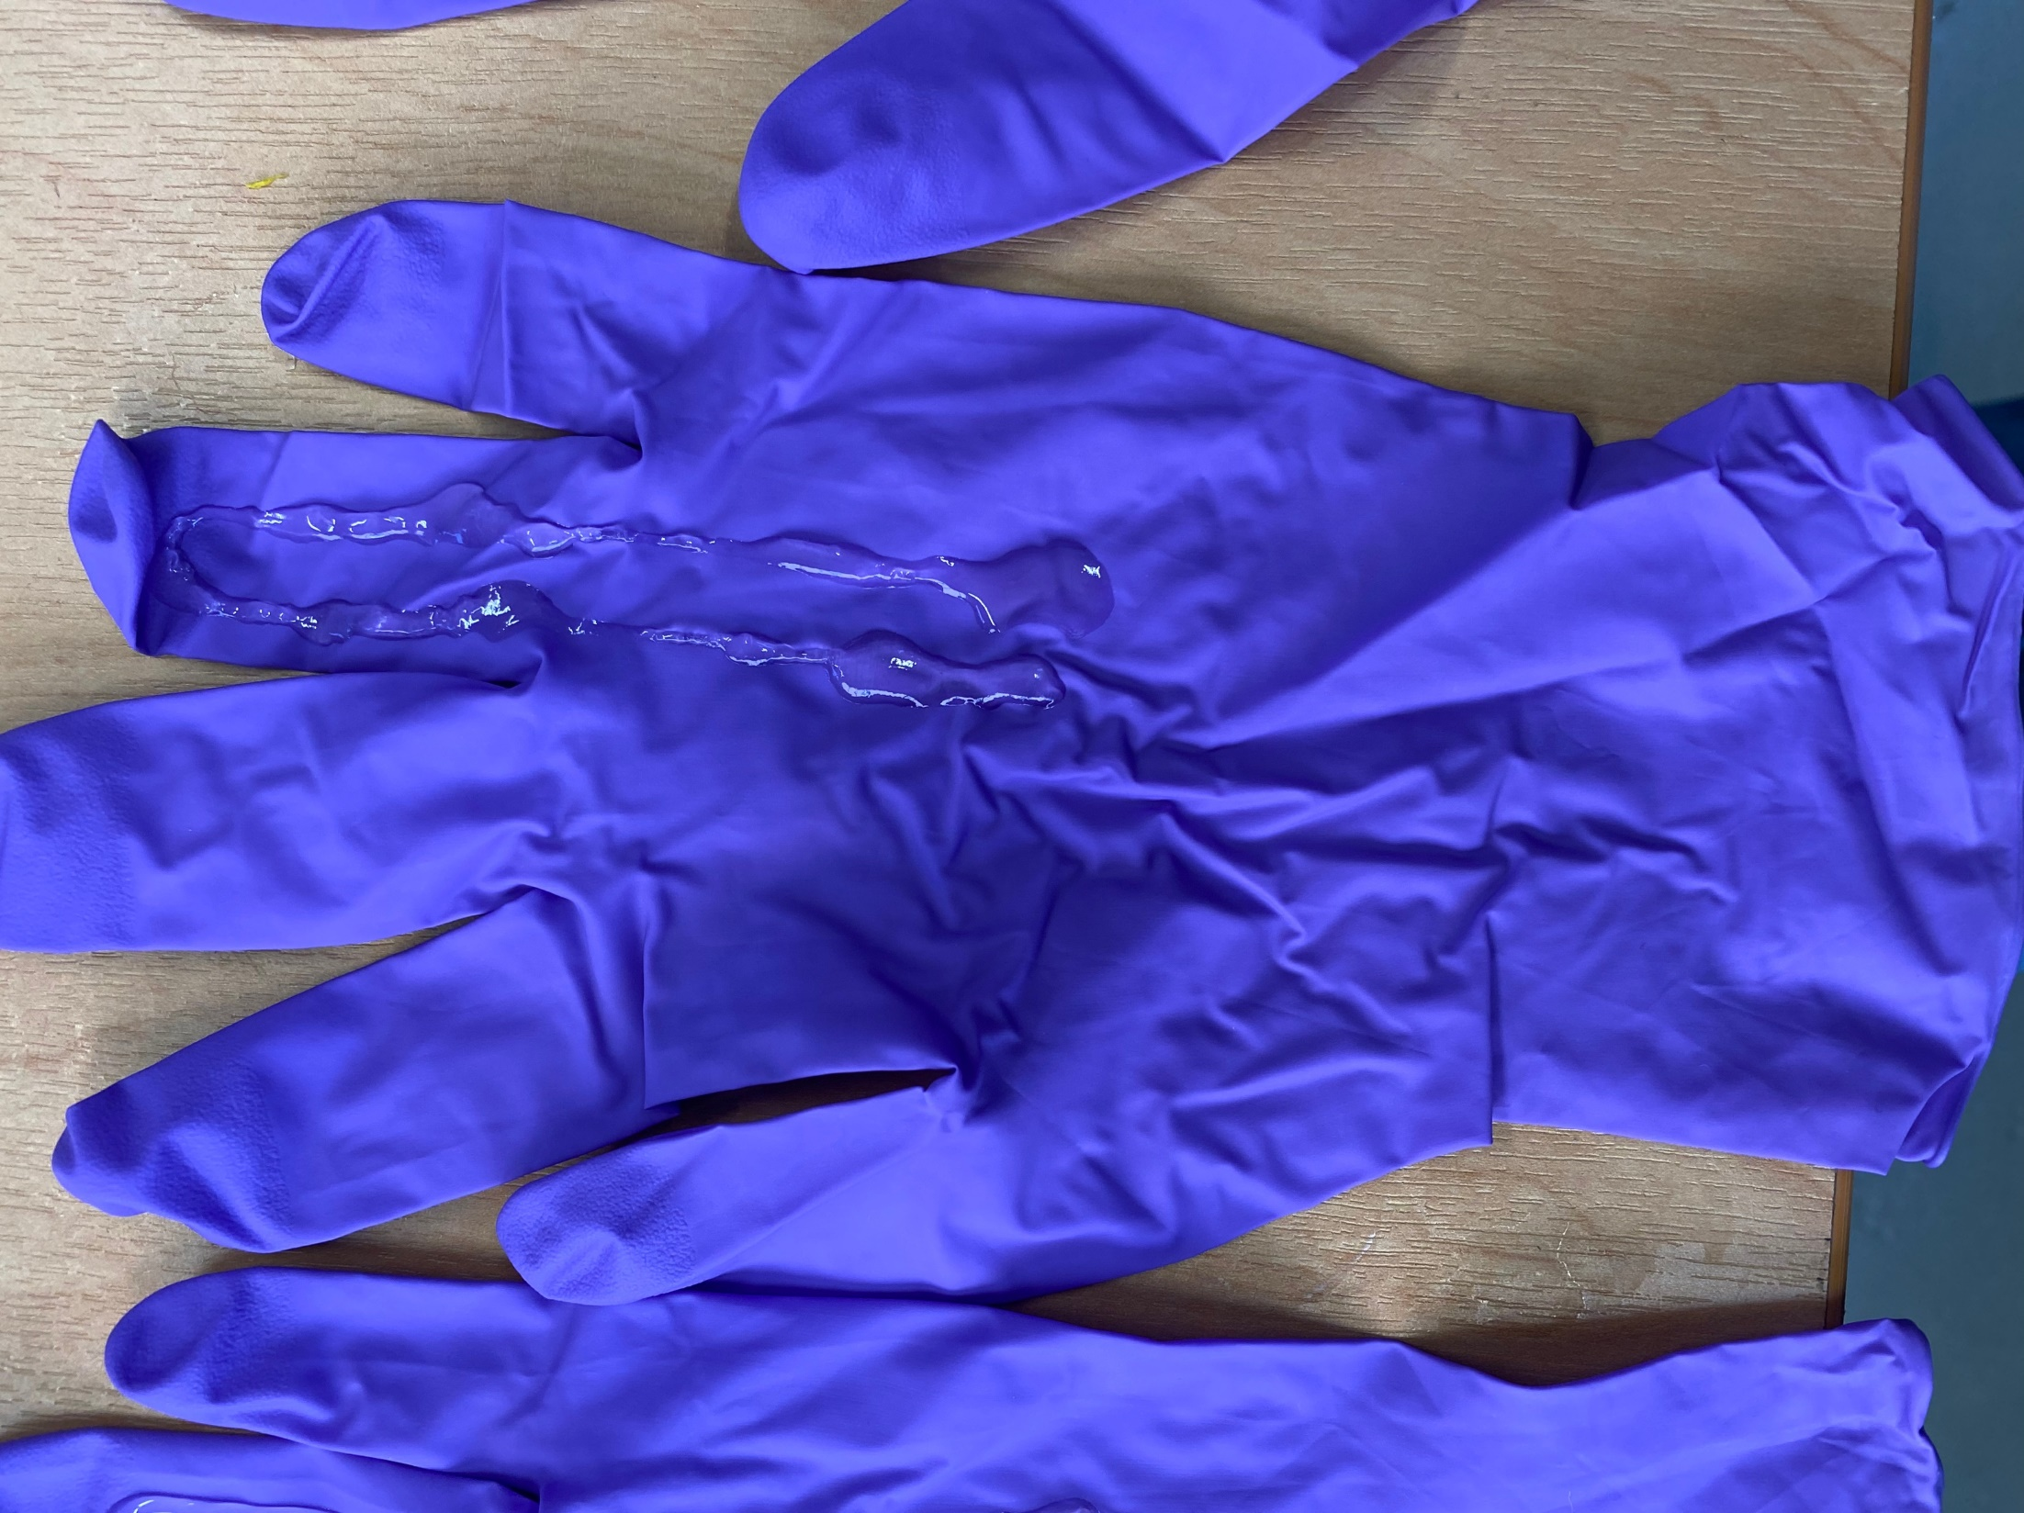
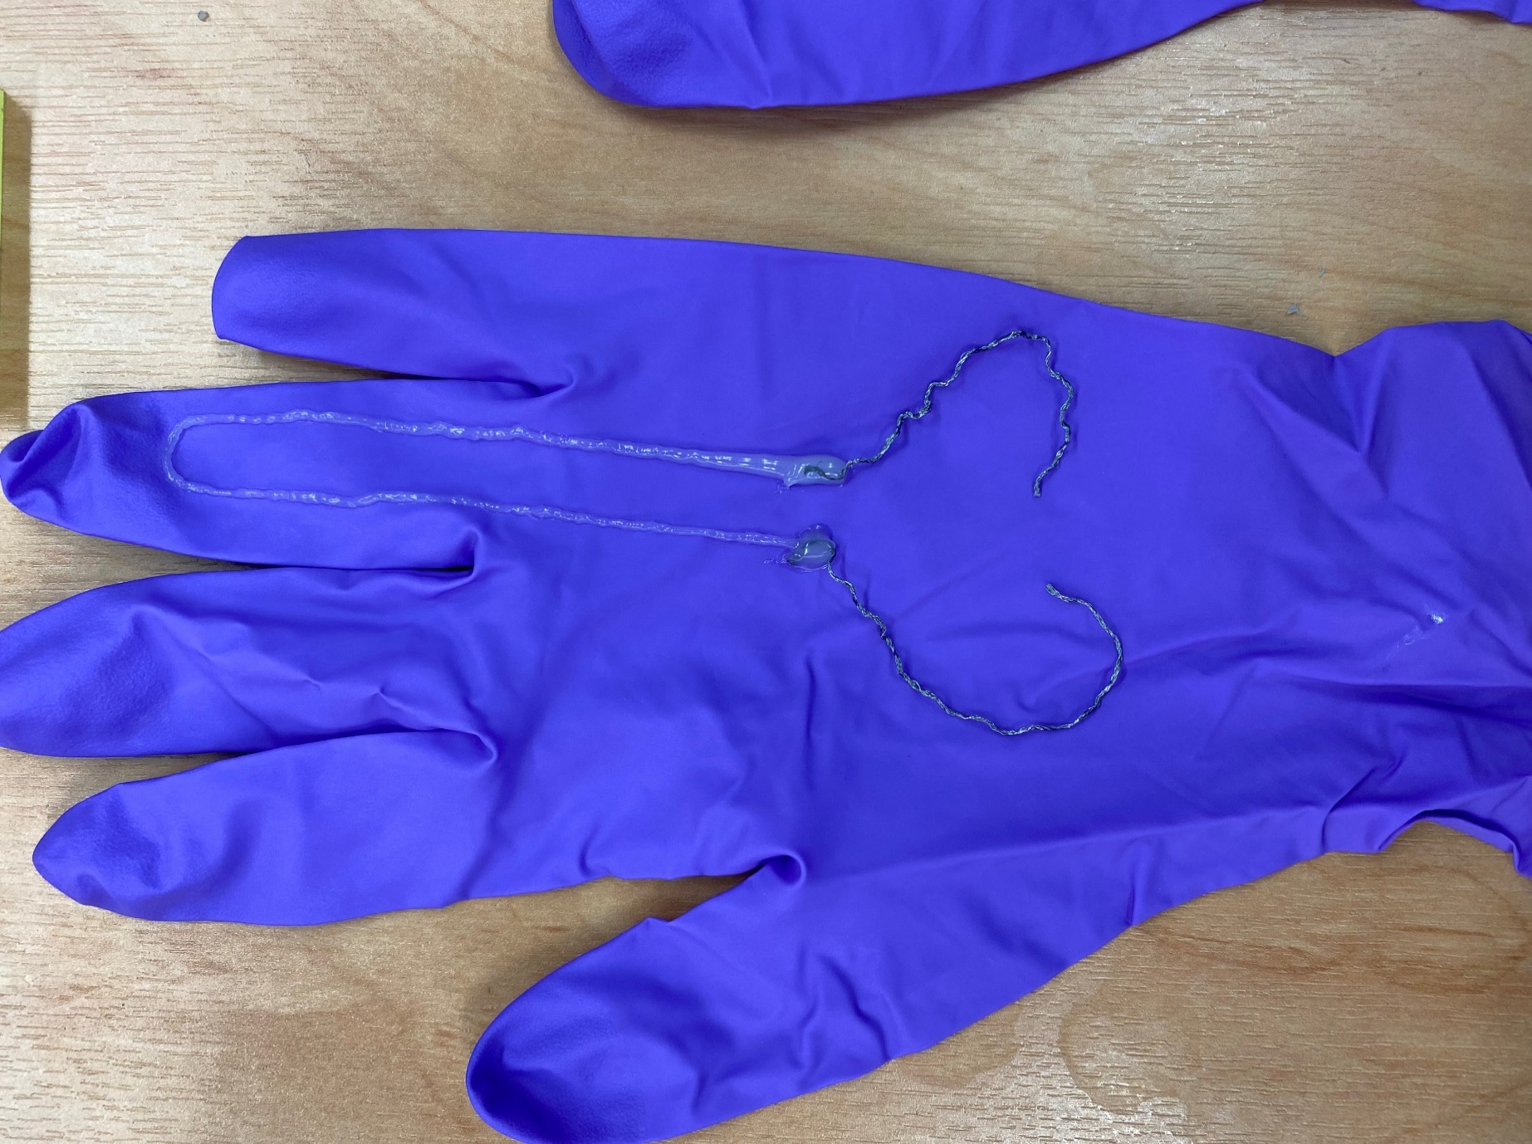
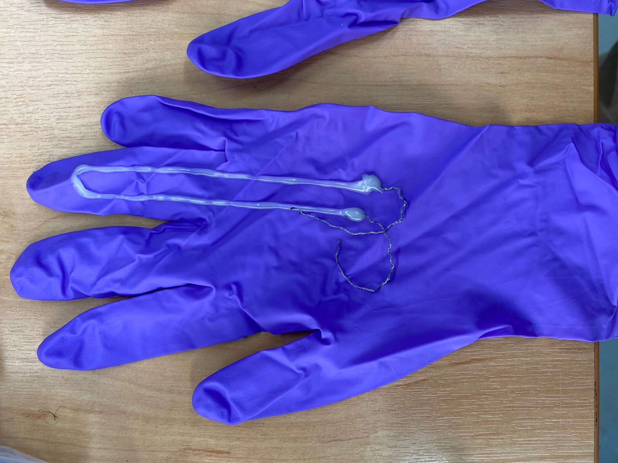
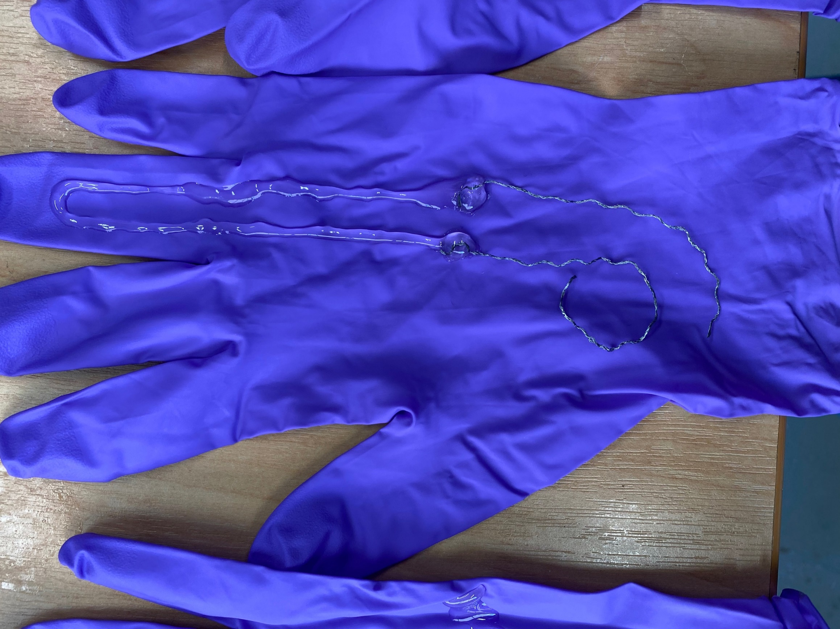
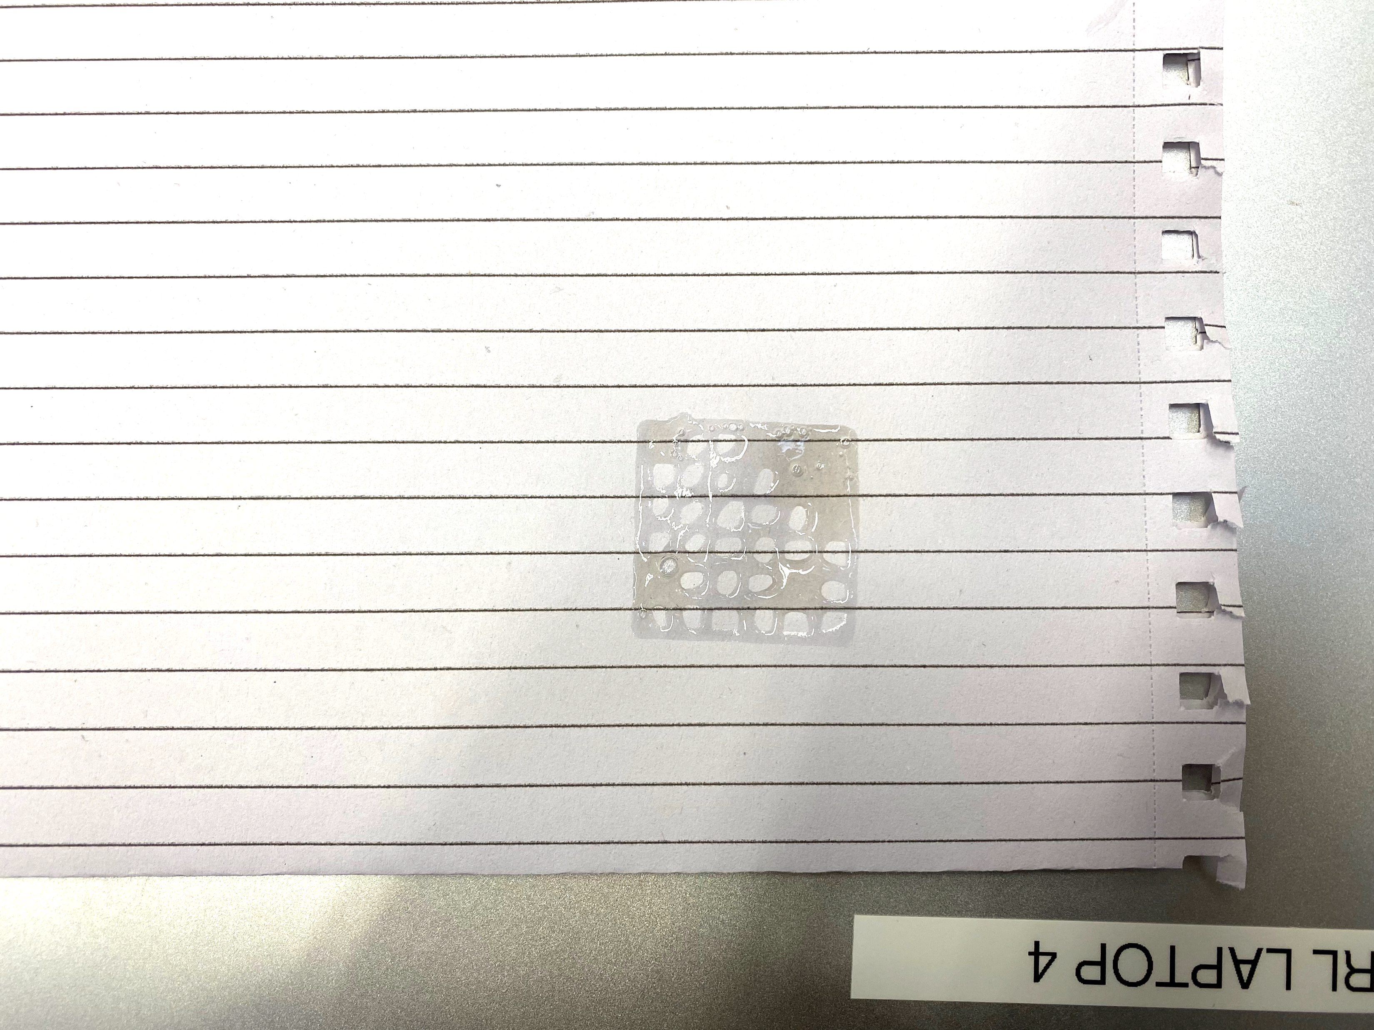
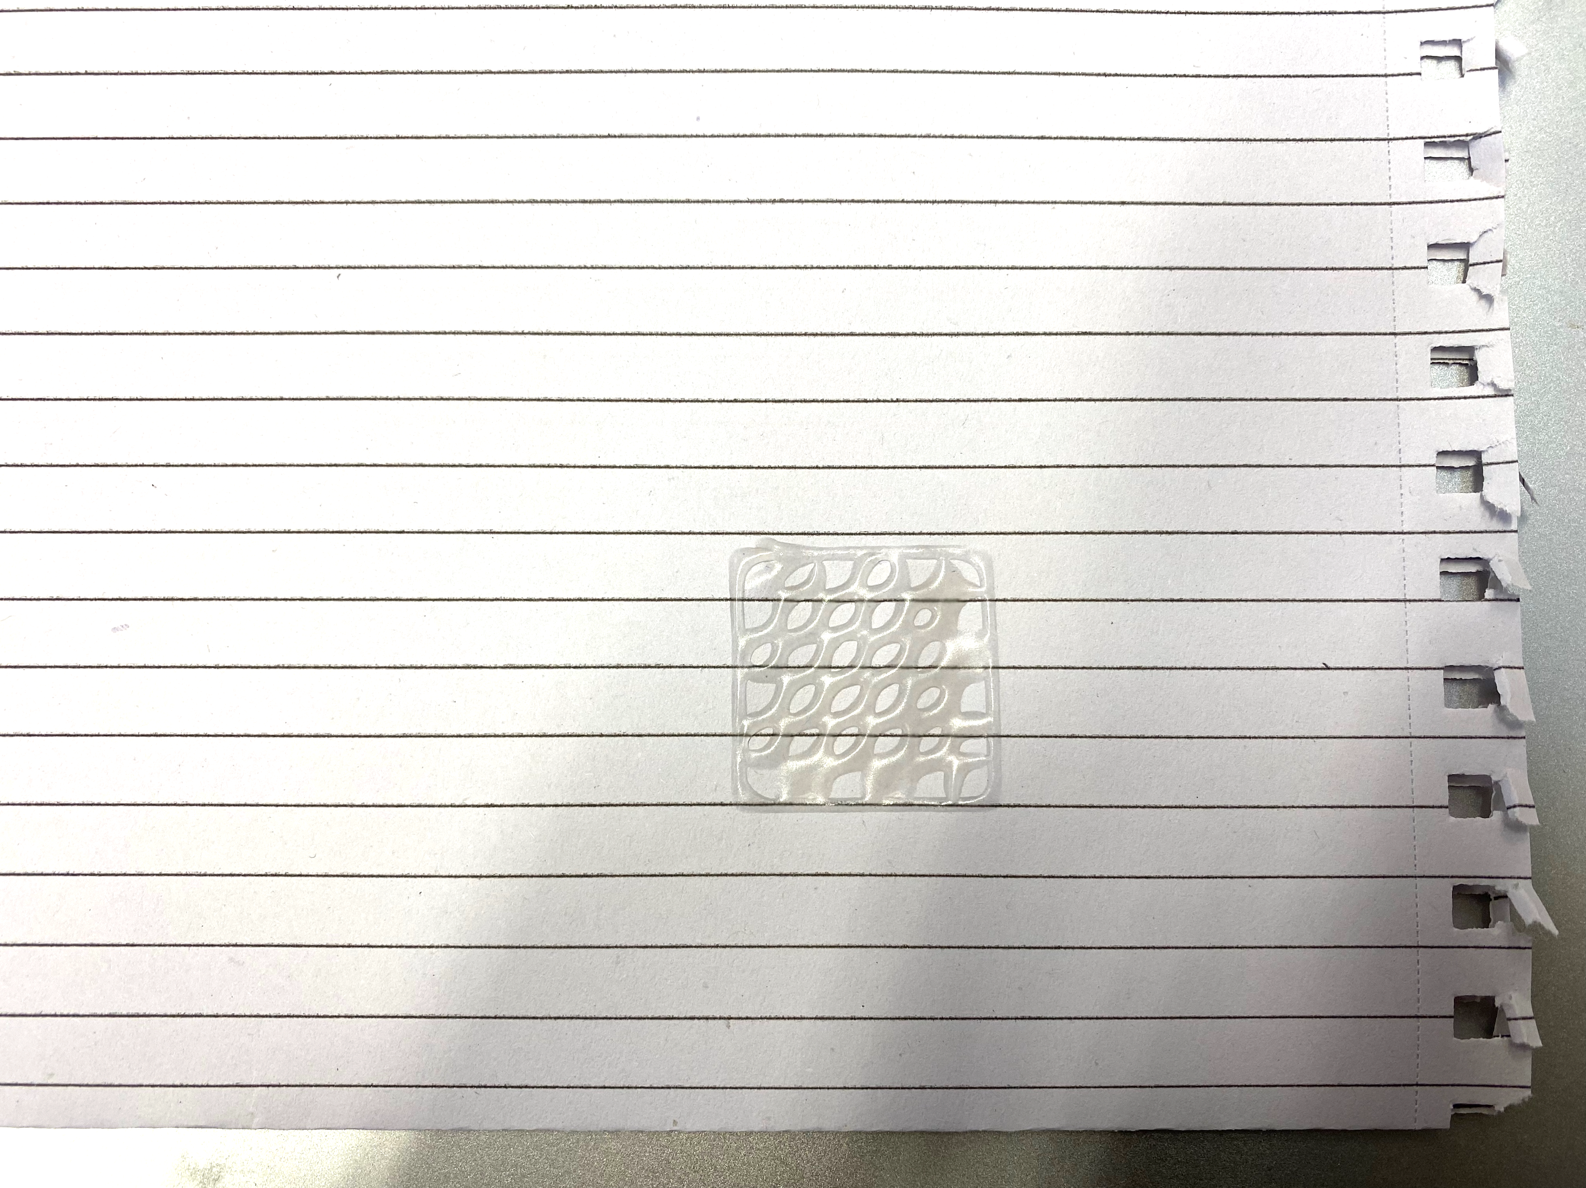
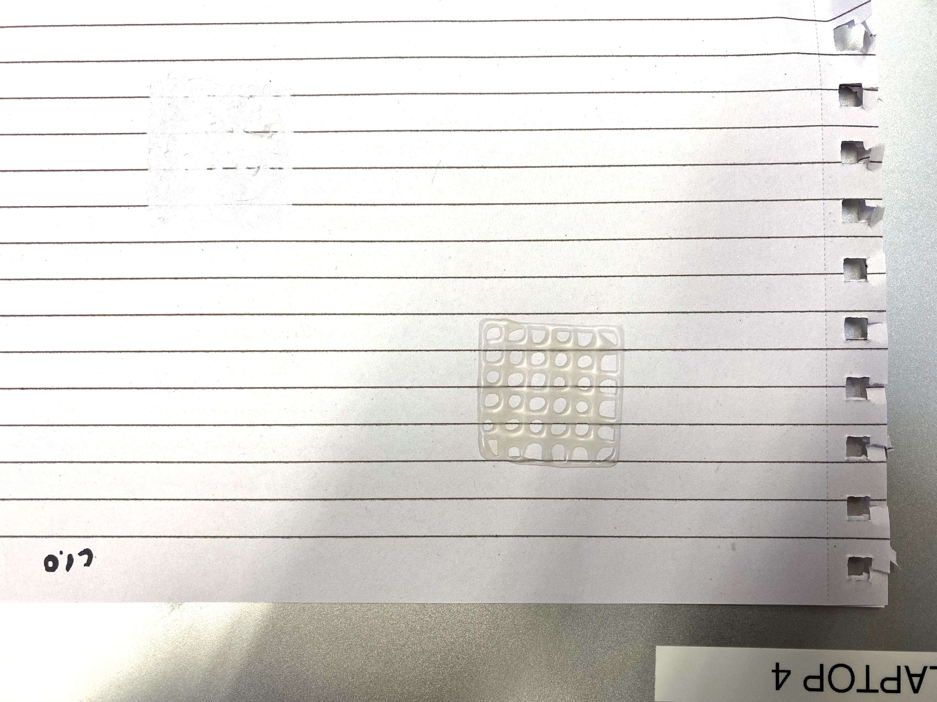
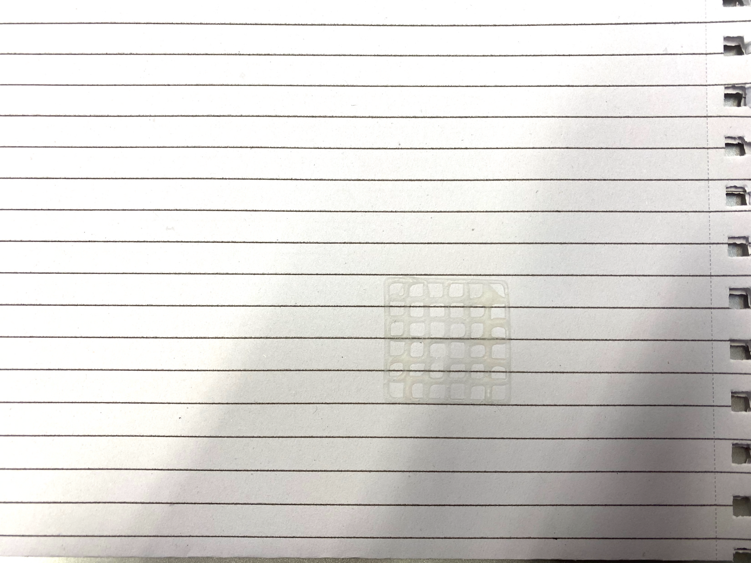
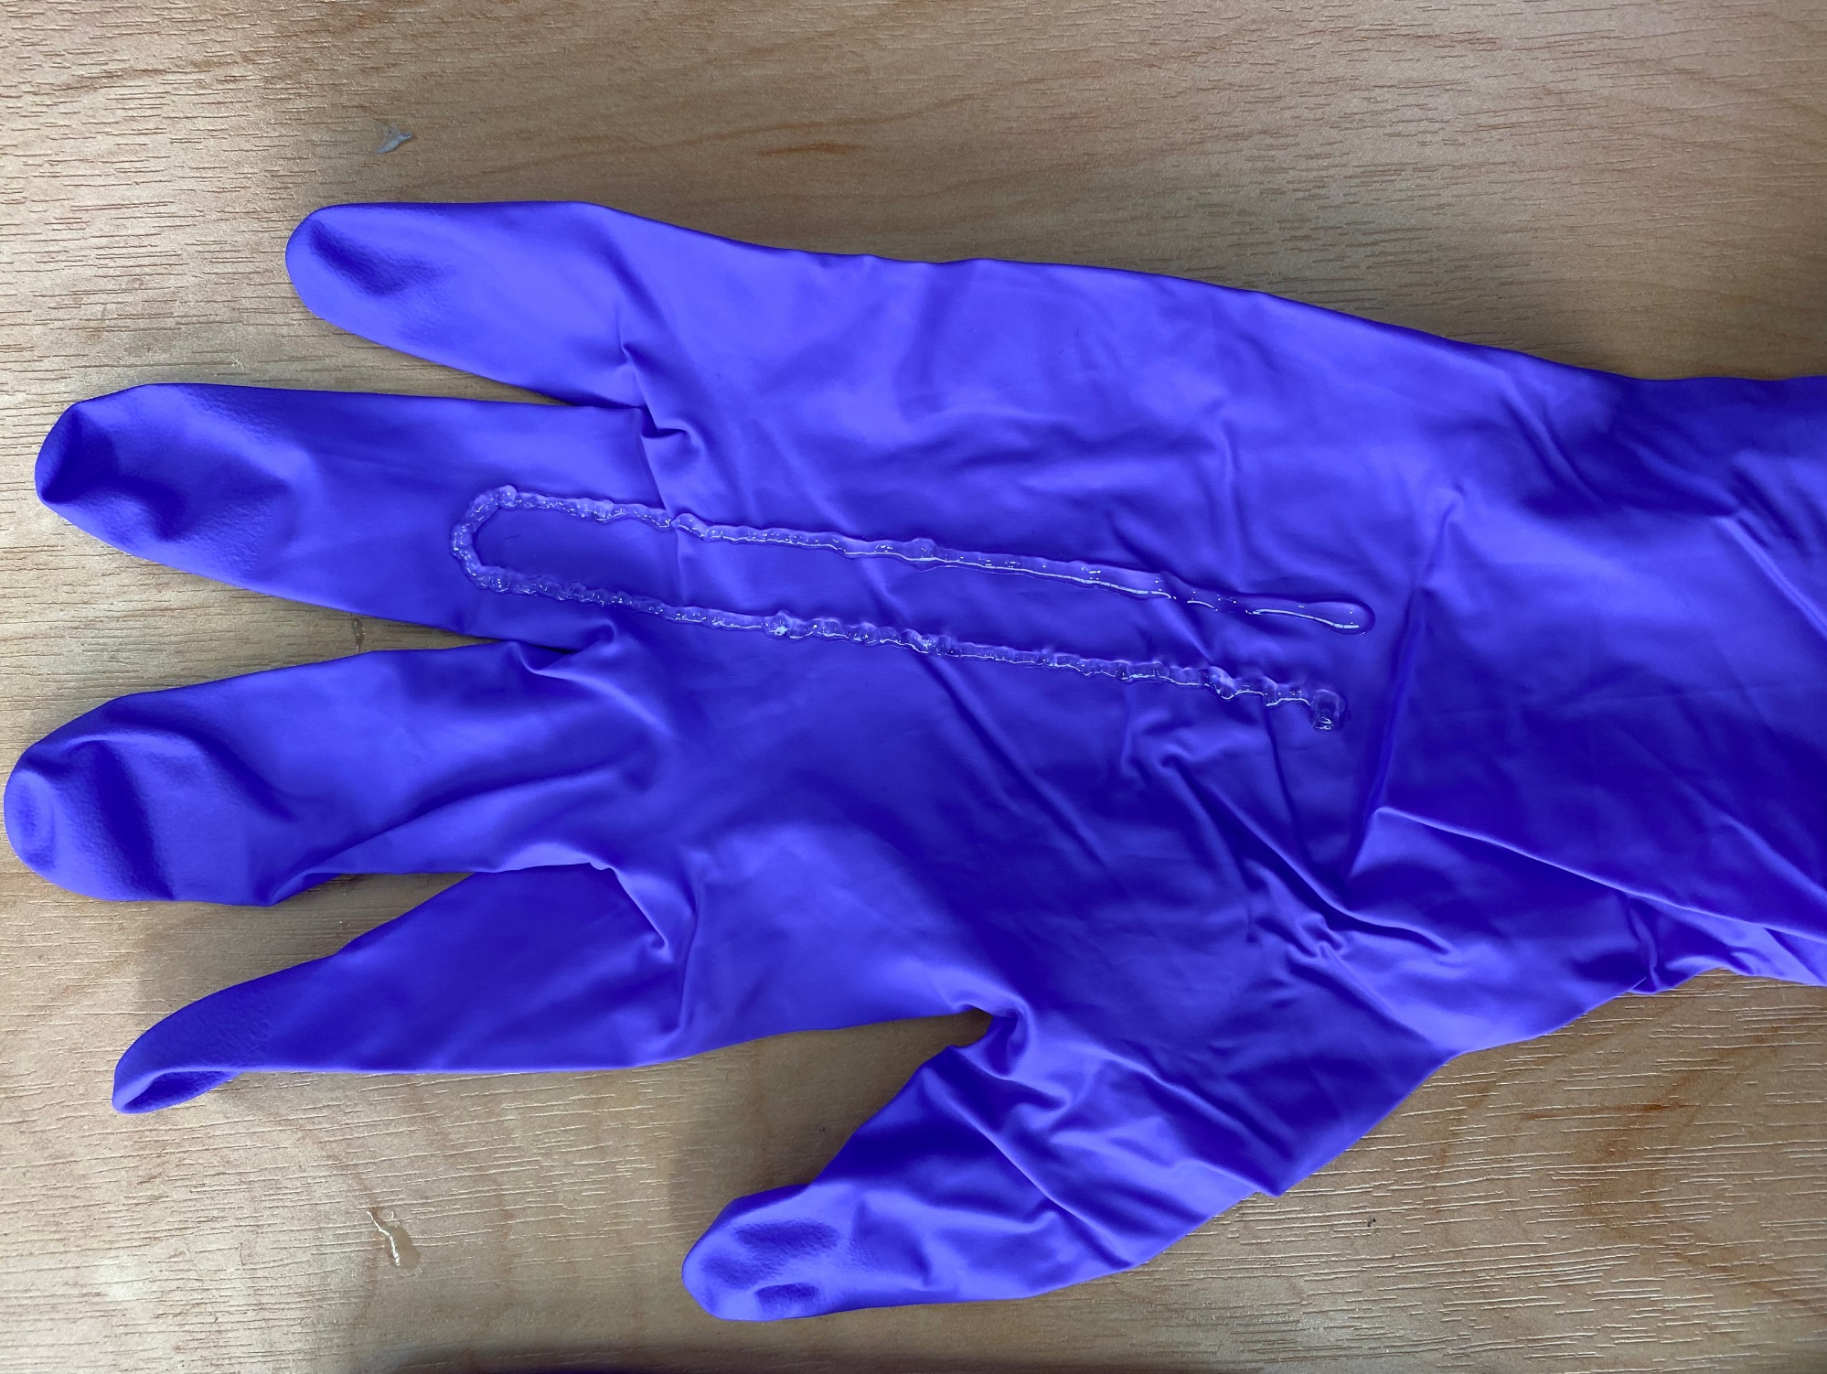

Figure3-3 (Print quality)
Original
30 ℃
Corn 20%wt
35 ℃
Corn 40%wt
35 ℃
Original
40 ℃
(b) Mesh shape print process
Original
Salt 4%wt→8%wt
+ Corn flour 20%wt
+ Corn flour 40%wt
Viscosity
Fine print zone
30 mm
Salt 8wt%
30 ℃
Corn 20%wt
45 ℃
No cornflour
Cornflour 20 wt%
Cornflour 40 wt%
Cornflour 60 wt%
30℃
35℃
40℃
45℃
Temperature
Viscosity
Fine print zone
(a) Fine print viscosity
Corn flour amount
(c) Mesh print results
Fig.3 Cornflour print: printability by the amount of cornflour.
Shear thinning
Continuous extrusion
Rapid viscosity increase
No delamination
Rapid viscosity increase ← Contact angle
Apporopriate viscosity ← Mesh test
Material electric property ← cast test
Gelatine 60%wt
Glaphene 10%wt
Notes:
1) the polymers should be highly thixotropic and exhibit shear thinning behavior,
2) appropriate viscosity such that the material can be extrudable and form continuous filaments to ensure structure fidelity,
3) Undergoes a rapid viscosity increase after extrusion to retain the 3D printed shape,
4) sufficient mechanical strength after exiting the nozzle is required to support the subsequently printed structures and to prevent delamination during and after printing.

Slide 11




Figure3-2 (Salt vs base resistance)
Fig.4-1 As the amount of salt increases, the baseline resistance decrease.
The influence by time was also examined.
Being stickey
(a)
(b)
Stress -Strain
Strain-Resistance
(c)
(d)

Slide 12











Figure4 (Simple sensor shape and sensitivity)
Fig.4 Sensitivity according to the sensor shape
Full
Middle
Base resistance
Thin
Thick
(a)
(b)
(c)
Thickness
Notes:
Font and line size

Slide 13






Figure 5 Optimization diagram
Simulation
phase
Real-world
phase
Control Input
Output
0
① Offset
Pose difference ratio
0.5
1
Target motion 1
Deciding
next shape
Generating
print code
Start
Target
Motion
Bayesian
optimization
3D print
② Start
③ End
Pose 1
Pose 2
Pose 3
Target motion 2
Learning
the results
Measurement
④ Angle
⑤ Width
θ
w
Complete
Optimized shape
0°≦ θ ≦ 45°
7 mm ≦ w ≦ 14 mm
Pose 4
Pose 5

Slide 14





Figure 5 Optimization diagram
Simulation
phase
Real-world
phase
Control Input
Output
0
① Offset
Pose difference ratio
0.5
1
Target motion 1
Deciding
next shape
Generating
print code
Start
Target
Motion
Bayesian
optimization
3D print
② Start
③ End
Pose 1
Pose 2
Pose 3
Target motion 2
Learning
the results
Measurement
④ Angle
⑤ Width
θ
w
Complete
Optimized shape
0°≦ θ ≦ 45°
7 mm ≦ w ≦ 14 mm
Pose 4
Pose 5

Slide 15







Figure 6 Optimization results
Better
Worse
1
2
3
43
44
45
・・・

Slide 16
Figure 6 Optimization results
(a) Tennis input
(b) Tennis output
(c) 3 motions input
(d) 3 motions output

